Slide 1
Renewable Energy Quiz

Slide 2
In which of the following devices could this energy flow chart represent the energy transformation taking place?
kinetic energy → electrical energy
A. a wind turbine in a town
B. a chemical battery in a torch light
C. a solar panel on a house
D. a Bunsen burner in a laboratory

Slide 3
Which of the following best describes the greenhouse effect on Earth?
A. The greenhouse effect gives the sky its blue colour and the sea its blue-green colour.
B. The greenhouse effect is the result of industrial pollution and man-made fires.
C. The greenhouse effect is the ‘trapping’ of some of the Earth’s infrared radiation in the atmosphere.
D. The greenhouse effect is caused by the hole in the ozone layer.

Slide 4
The greenhouse effect is necessary for life on Earth because:
A. it shields us from the Sun’s ultraviolet radiation.
B. it helps keep the temperature of the Earth not too hot and not too cold.
C. it provides us with the oxygen gas we need for life.
D. it provides the carbon dioxide necessary for plants to photosynthesise.

Slide 5
Ozone molecules consist of:
A. oxygen atoms.
B. hydrogen and oxygen atoms.
C. carbon and oxygen atoms.
D. hydrogen and carbon atoms.

Slide 6
One reason why hydroelectric power stations do not contribute to global warming is:
A. they are very energy efficient.
B. they do not produce solid wastes.
C. they do not produce carbon dioxide.
D. they do not affect the ozone layer.

Slide 7
When a ball is dropped it doesn’t bounce back to the height from which it was dropped. The energy is transformed into:
A. heat energy and sound energy
B. sound energy only
C. kinetic energy and heat energy
D. heat energy only

Slide 8
Solar cells are classified as a renewable energy resource because:
A. solar cells can easily be replaced.
B. no carbon dioxide or water vapour is produced.
C. no waste heat energy is produced.
D. there is a continuing supply of energy from the Sun.

Slide 9
The position of the solar panel on a roof that would deliver the greatest electrical power is:
A. lying against one of the sloping faces that point towards the east.
B. horizontal, on the top edge of the roof.
C. lying against one of the sloping faces that point towards the north.
D. vertical, on the top edge of the roof, pointing due south.

Slide 10
The flow chart that shows the energy transformation occurring in a wind turbine is best represented by:
A. heat energy → electrical energy
B. gravitational potential energy → electrical energy
C. solar energy → electrical energy
D. kinetic energy → electrical energy

Slide 11
Which of the following is classified as a non-renewable energy resource?
A. Nuclear power station
B. Wind turbine generator
C. Hydroelectric power station
D. Geothermal power station

Slide 12
Which of the following is the symbol for a unit of electrical energy?
A. kW
B. V
C. W
D. kWh

Slide 13
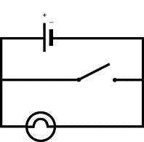
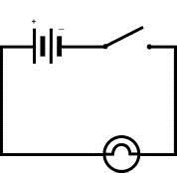
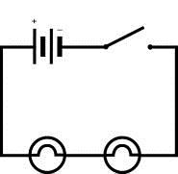
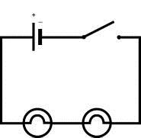
In which of the following circuits would the globe (or globes) glow brightest when the switch is closed (on)?
A B
C D

Slide 14
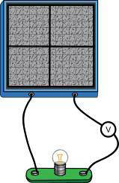
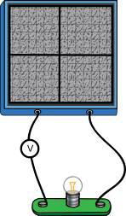
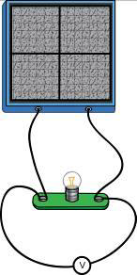
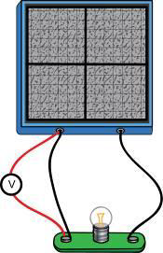
Which diagram shows the correct way of connecting a voltmeter to measure the voltage across the lamp?
A B C D

Slide 15
Which one of the following pairs of gases are both greenhouse gases?
A. Carbon dioxide gas and water vapour
B. Carbon dioxide gas and oxygen gas
C. Nitrogen gas and carbon dioxide gas
D. Water vapour and oxygen gas

Slide 16
The enhanced greenhouse effect may be causing a gradual increase in:
A. The amount of solar energy entering the Earth’s atmosphere
B. The amount of carbon dioxide in the Earth’s atmosphere
C. The amount of ultraviolet light reaching the Earth’s surface
D. The average temperature of the Earth’s atmosphere and surface

Slide 17
Which one of the following is NOT likely to be a result of global warming?
A. Increased volcanic activity
B. Rising sea levels
C. Melting of polar ice caps
D. More extreme weather events

Slide 18
The enhanced greenhouse effect:
A. has been occurring for millions of years.
B. is caused by the hole in the ozone layer.
C. is essential for life on Earth.
D. has been caused by increased human activity.

Slide 19
Which ball has the most gravitational potential energy?
A. A tennis ball held one metre above the ground
B. A tennis ball resting on the ground
C. A tennis ball rolling along the ground
D. A tennis ball sitting at the bottom of a well

Slide 20
Which household appliance or device carries out the following energy transformation?
Electrical energy → Mechanical energy A. Compact fluorescent lamp
B. MP3 player
C. Washing machine
D. Electric oven

Slide 21
Which of the following is the international unit for measuring electrical current?
A. joule
B. ampere
C. volt
D. watt

Slide 22
Why is a wind turbine classified as a renewable energy resource?
A. The blades of the turbine can easily be replaced.
B. No carbon dioxide or water vapour is produced.
C. Only a minimal amount of waste heat energy is produced.
D. There is a continuing supply of kinetic energy from the wind.

Slide 23
Which one of the following factors is least important in determining whether a site is a suitable location for a wind farm?
A. The shape of the surrounding land
B. The average wind speeds in the area
C. The average temperatures in the area
D. The flight patterns of local birds

Slide 24
When a wind turbine is being installed in Australia, which way should the turbine blades face?
A. North because Australia is in the southern hemisphere
B. South so they can use the strong winds coming from Antarctica
C. West to use the strong winds that often blow across Australia
D. Able to turn around to face the prevailing wind

Slide 25
What is the main disadvantage of solar power?
A. Solar panels only produce low voltages.
B. Solar panels can become covered with dust.
C. Solar panels do not produce electrical energy at night.
D. Solar panels do not always directly face the Sun.

